Slide 1
LEAN MANUFACTURING: CNC MACHINING WITH ERROR DETECTION
Presented by Lemuel Hornsby Odoi

Slide 2
TABLE OF CONTENTS
01
02
03
04
INTRODUCTION
PROBLEM DEFINITION
DATA
NAME OF THE SECTION

Slide 3
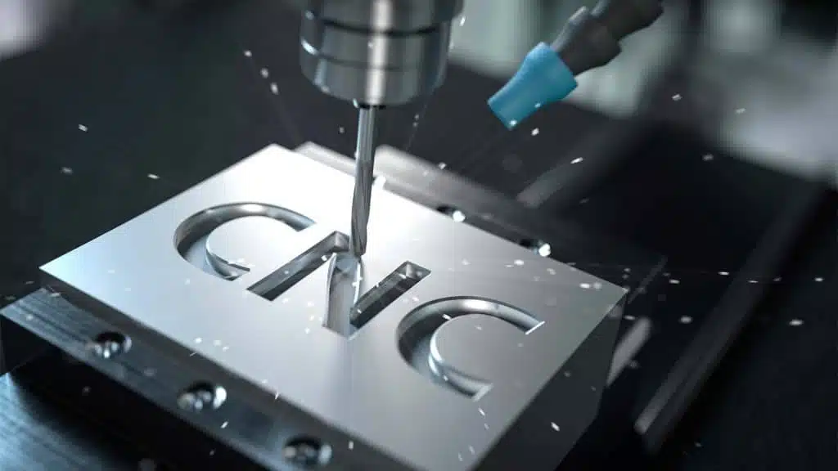
01
INTRODUCTION

Slide 9
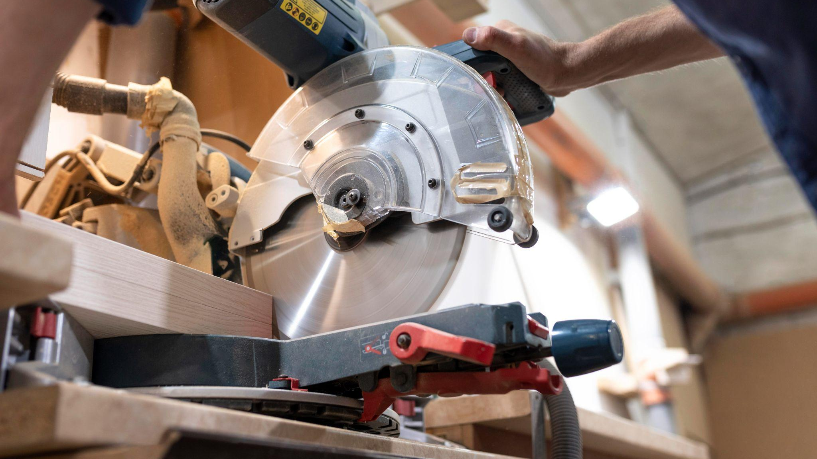
A PICTURE IS WORTH A THOUSAND WORDS

